Slide 1

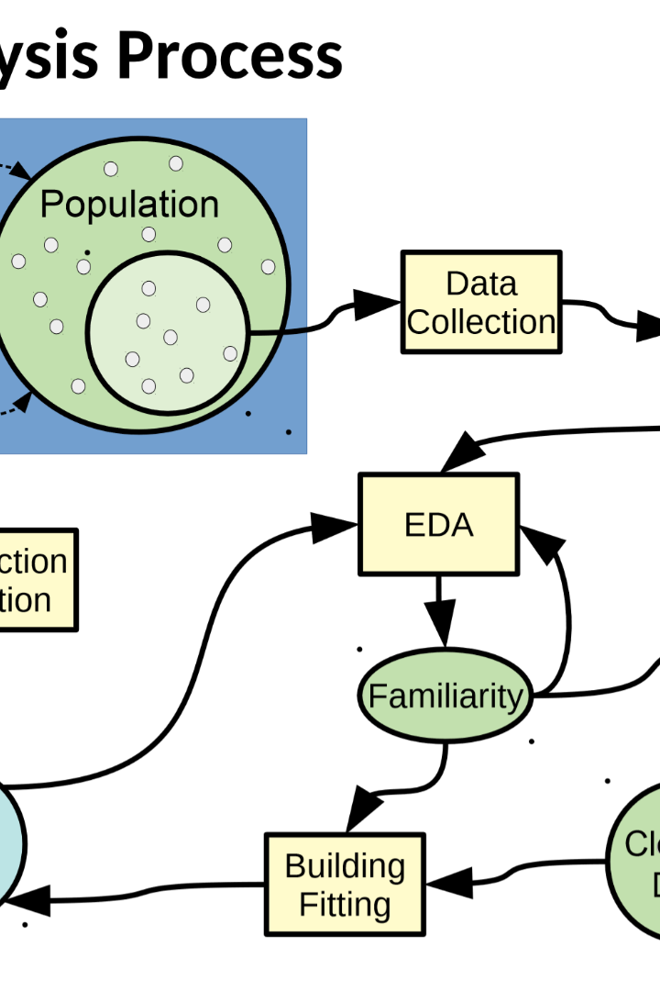

Product Sales Analysis of a Region Over the Years
Welcome to our presentation on the product sales analysis of a region over the years. In this presentation, we will explore the data using IBM Cognos for data exploration and visualization. We will also discuss the application of supervised learning in Jupyter Notebook using Python. Join us on this journey as we uncover valuable insights from the data and showcase its impact on business growth.

Slide 2
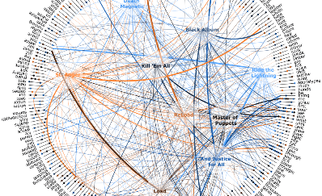
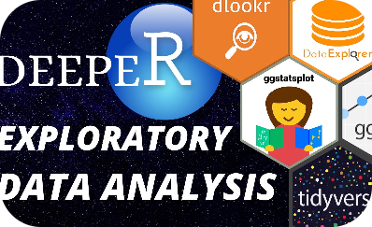
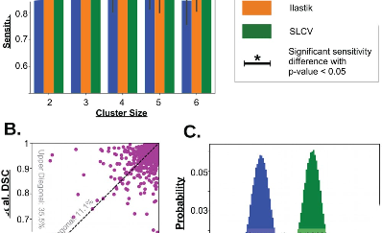
The Power of Data Visualization
Effortless Data Interpretation
Uncover Hidden Patterns
Predictive Modeling
Supervised learning in Jupyter Notebook using Python allows us to build predictive models that can forecast sales trends and identify potential growth opportunities.
Data visualization allows us to present complex information in a graphical format, making it easier for stakeholders to interpret and understand key insights at a glance.
By exploring the data using powerful tools like IBM Cognos, we can uncover hidden patterns and correlations, enabling us to make data-driven decisions with confidence.

Slide 3

The Journey Begins: Exploratory Data Analysis
1
Data Collection
The first step is to collect relevant sales data from various sources, ensuring accuracy and completeness.
2
Data Cleaning
We then clean the data by removing duplicates, handling missing values, and fixing any inconsistencies, ensuring high data quality.
3
Exploratory Data Analysis
Using IBM Cognos, we perform exploratory data analysis to gain initial insights, identify trends, and discover outliers.

Slide 4
Data Exploration in python for dataset:
Data exploration is a critical step in the data analysis process, as it allows you to gain a better understanding of your dataset. In Python, you can use various libraries like Pandas, Matplotlib, and Seaborn for data exploration.Here's a step-by-step guide to performing data exploration on your dataset:

Slide 5
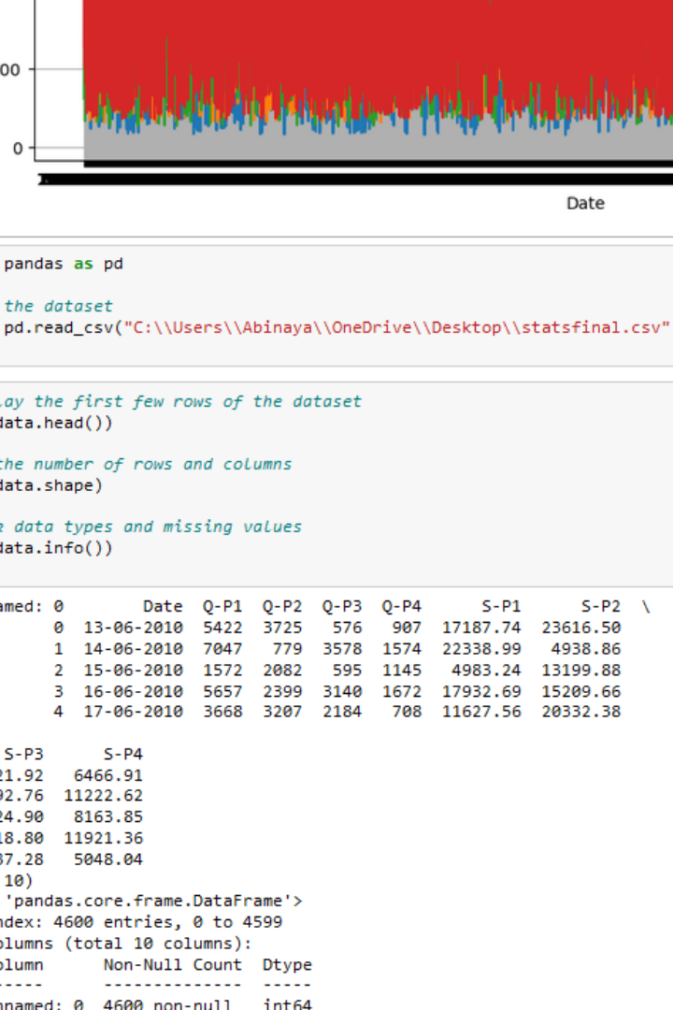
Load the Dataset:
Start by loading your dataset using Pandas. If your data is in a CSV file, you can use pd.read_csv().

Slide 6
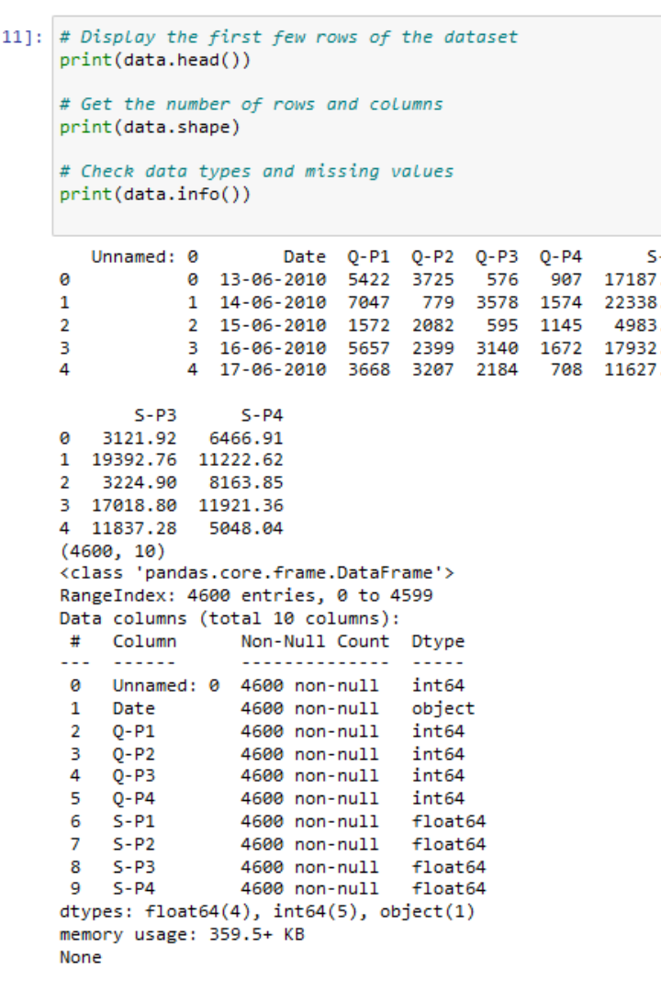
Basic Information:
Check the basic information about your dataset, including the number of rows, columns, data types, and missing values.

Slide 7
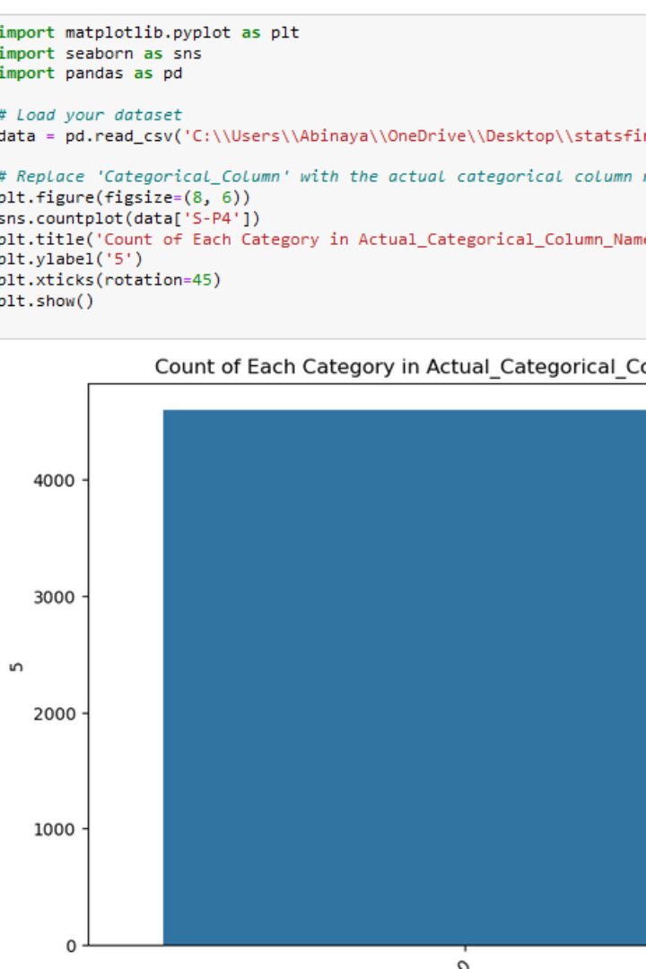
Data Visualization:
Visualize the data to identify patterns, trends, and relationships. Use libraries like Matplotlib and Seaborn for plotting.

Slide 8
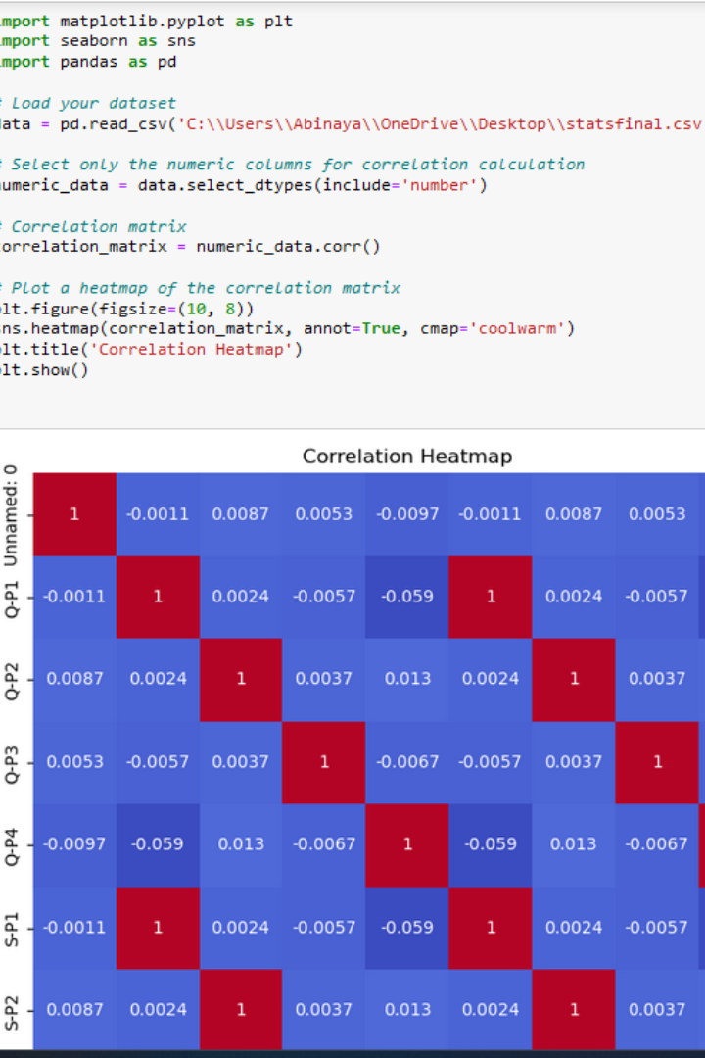
Correlation Analysis:
Check for correlations between variables, especially in numerical datasets.

Slide 9

Supervised Learning:
Training Data:
Start with a dataset that contains input-output pairs. The input data is often referred to as features, attributes, or independent variables, while the output is called the target, label, or dependent variable.
Algorithm Training:
You choose a machine learning algorithm (e.g., decision trees, linear regression, neural networks, etc.) and train it using the labeled data. During training, the algorithm learns the relationships between the input data and the corresponding output.
Model Evaluation:
After training, you evaluate the model's performance using a separate dataset that the model hasn't seen before. Common evaluation metrics include accuracy, mean squared error, F1 score, and others, depending on the type of problem

Slide 10


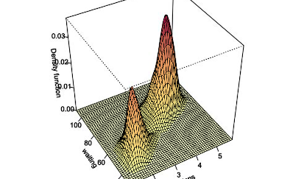
The Power of Machine Learning: Predictive Modeling
:Data Preparation
:
Sales Forecasting
Before building the predictive model, we carefully prepare the data by selecting relevant features, handling categorical variables, and scaling the data for optimal performance.
With the trained predictive model, we can forecast future sales, allowing businesses to plan and strategize effectively to achieve their targets.

Slide 11
Unlocking the Power of Data: Key Takeaways:
Data Visualization
Predictive Modeling
Actionable Insights
Present complex information in a visual format
Optimize sales strategies and enhance customer experience
Forecast future sales trends accurately
Gain quick insights and make informed decisions
Identify growth opportunities in specific regions and product categories
Identify market trends and stay ahead of the competition
Communicate findings effectively to stakeholders
Unlock the full potential of data-driven decision-making
Optimize resource allocation for business growth

